Slide 1


Hybrid Polystore Framework
Maxime Gobert
Loup Meurice
Supervised by Anthony Cleve

Slide 2
Context

Slide 3
Hybrid database system or polystore
Notes:
Hybrid databases system example
Evolution scenario and artefact to modify

Slide 4
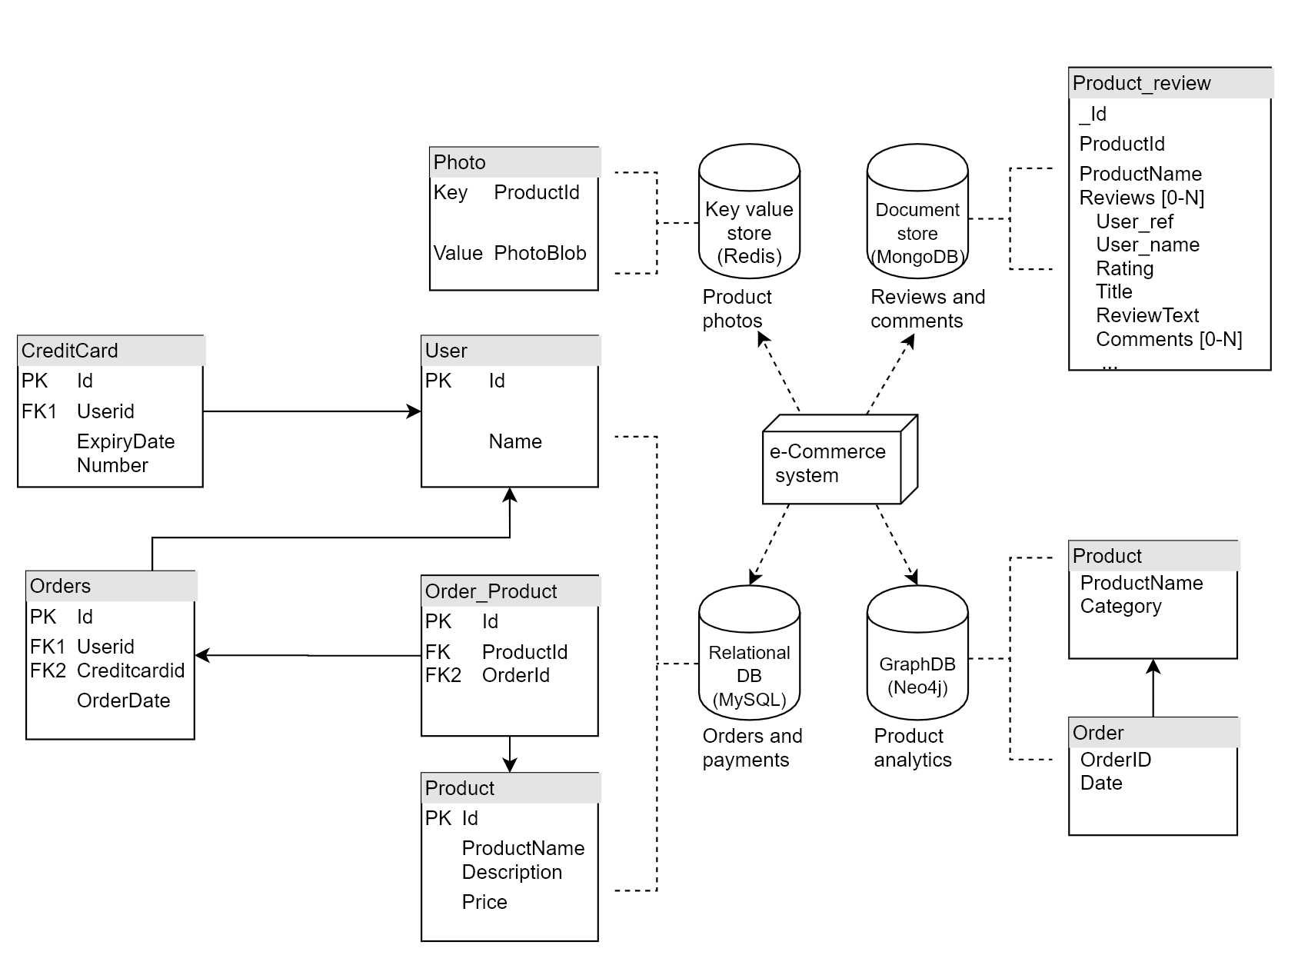
Notes:
Hybrid databases system example
Evolution scenario and artefact to modify

Slide 5
Notes:
Hybrid databases system example
Evolution scenario and artefact to modify

Slide 6
Notes:
Hybrid databases system example
Evolution scenario and artefact to modify

Slide 7
Notes:
Hybrid databases system example
Evolution scenario and artefact to modify

Slide 8
Notes:
Hybrid databases system example
Evolution scenario and artefact to modify

Slide 9
Physical schema
Notes:
Separated DB but not independent

Slide 10
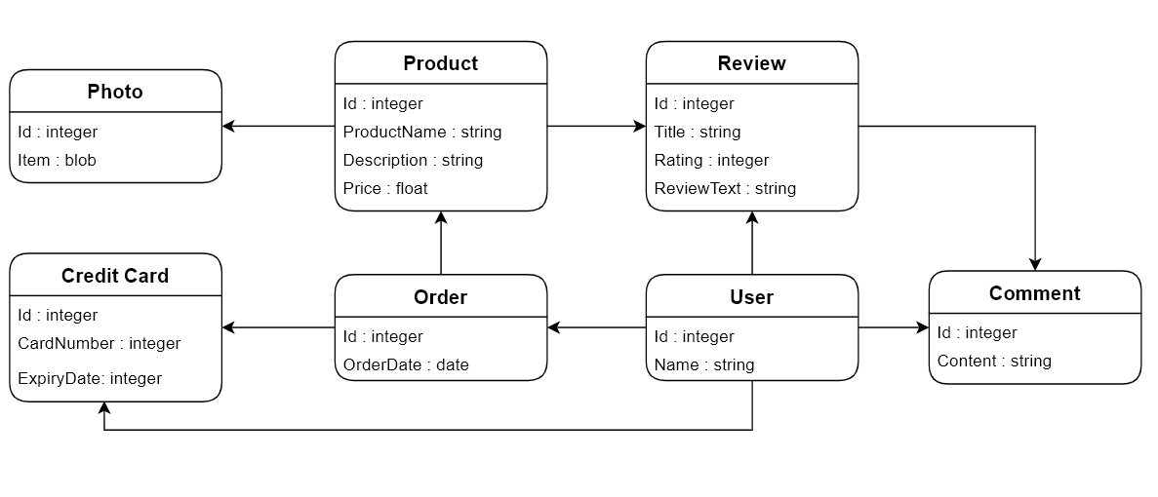
Conceptual Schema
Notes:
They rely on an implicit Conceptual schema

Slide 11
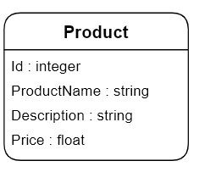
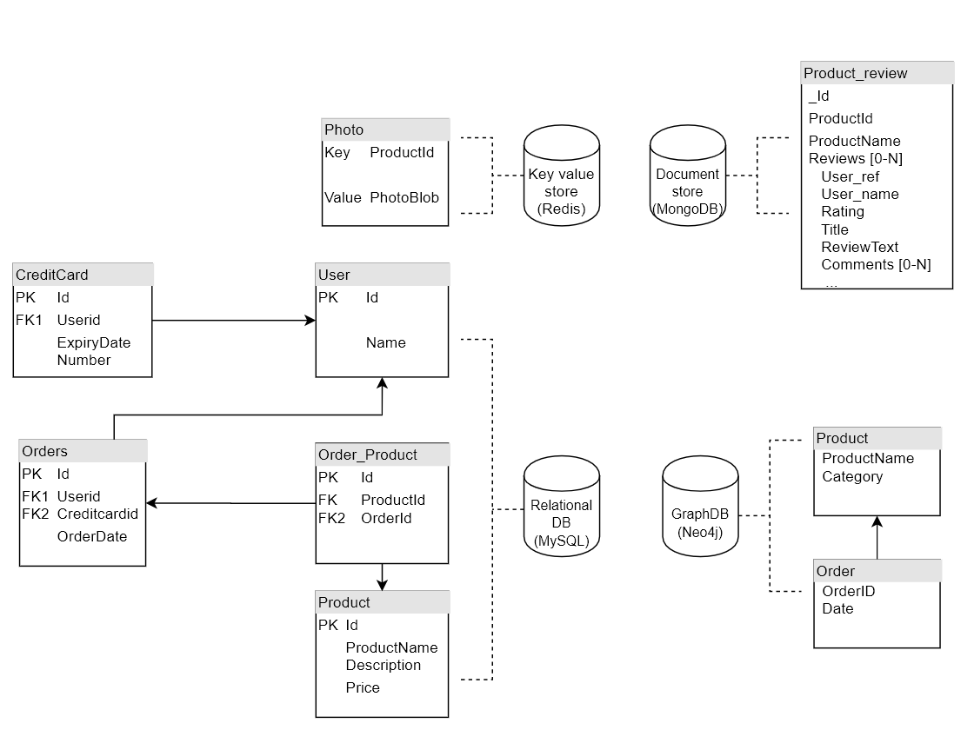
Notes:
Overlapping / redundancy / data duplication

Slide 12
Notes:
Overlapping / redundancy / data duplication

Slide 13
Notes:
Overlapping / redundancy / data duplication

Slide 14
Notes:
Overlapping / redundancy / data duplication

Slide 15
Notes:
Overlapping / redundancy / data duplication

Slide 16
Notes:
Overlapping / redundancy / data duplication

Slide 17
Data and Queries
Notes:
Hybrid databases system example
Evolution scenario and artefact to modify

Slide 18
Data and Queries
{
"_id": "5df8b60952264a01b6a8a2fc",
"productId": "product0",
"productName": "SuperCleaner3",
"reviews": [
{
"review_id": "review1",
"user_ref": "user55",
"user_name": "Serena",
"rating": 1,
"title": "Dont buy!!!",
"reviewText": "I dropped it from a 5 stories building and it broke!",
"comments": []
},
...
]
}
}
Notes:
Hybrid databases system example
Evolution scenario and artefact to modify

Slide 19
Data and Queries
{
"_id": "5df8b60952264a01b6a8a2fc",
"productId": "product0",
"productName": "SuperCleaner3",
"reviews": [
{
"review_id": "review1",
"user_ref": "user55",
"user_name": "Serena",
"rating": 1,
"title": "Dont buy!!!",
"reviewText": "I dropped it from a 5 stories building and it broke!",
"comments": []
},
...
]
}
}
DocumentDB dbcollection.find({productName:"SuperCleaner3"})
Notes:
Hybrid databases system example
Evolution scenario and artefact to modify

Slide 20
Data and Queries
{
"_id": "5df8b60952264a01b6a8a2fc",
"productId": "product0",
"productName": "SuperCleaner3",
"reviews": [
{
"review_id": "review1",
"user_ref": "user55",
"user_name": "Serena",
"rating": 1,
"title": "Dont buy!!!",
"reviewText": "I dropped it from a 5 stories building and it broke!",
"comments": []
},
...
]
}
}
DocumentDB dbcollection.find({productName:"SuperCleaner3"})
GraphDB
match (n:Product{productName:“SuperCleaner3"})<--(o:Order)-->(otherProducts:Product) return n,o,otherProducts
Notes:
Hybrid databases system example
Evolution scenario and artefact to modify

Slide 21
Data and Queries
{
"_id": "5df8b60952264a01b6a8a2fc",
"productId": "product0",
"productName": "SuperCleaner3",
"reviews": [
{
"review_id": "review1",
"user_ref": "user55",
"user_name": "Serena",
"rating": 1,
"title": "Dont buy!!!",
"reviewText": "I dropped it from a 5 stories building and it broke!",
"comments": []
},
...
]
}
}
DocumentDB dbcollection.find({productName:"SuperCleaner3"})
GraphDB
match (n:Product{productName:“SuperCleaner3"})<--(o:Order)-->(otherProducts:Product) return n,o,otherProducts
Relational DB
Select userid from Orders O JOIN Order_Product OP ON O.Id=OP.OrderId JOIN Product P ON OP.ProductId=P.Id where P.productName=“SuperClean3”
Notes:
Hybrid databases system example
Evolution scenario and artefact to modify

Slide 22
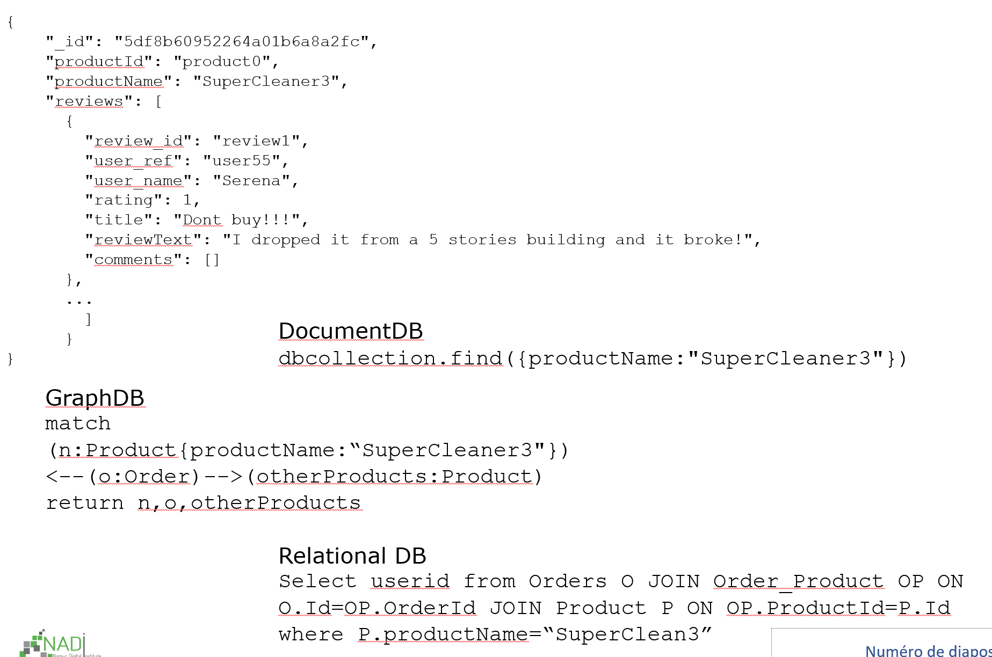
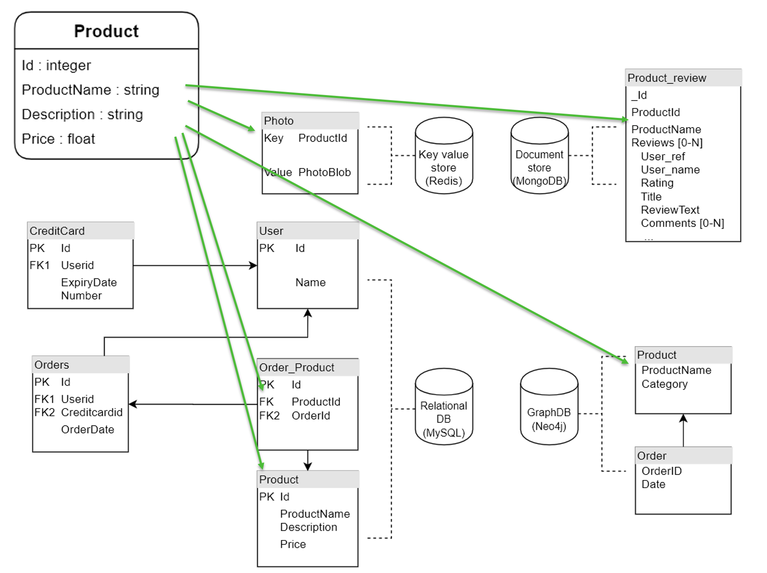
Hybrid database system
Notes:
Hybrid databases system example
Evolution scenario and artefact to modify

Slide 23
Hybrid Polystore Framework

Slide 24
Our approach
Focuses on multi databases systems, or polystores, possibly with heterogeneous data models
For such systems our framework will help with :
The conceptual design
The physical structure design
The mapping between them
The generation of ready to use access code
The management of system evolution
Notes:
Research questions

Slide 25
Design

Slide 26
Unified Model
Conceptual
Physical
Mapping

Slide 27
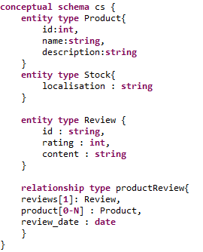
Unified Model
Conceptual
Physical
Mapping

Slide 28
Unified Model
Conceptual
Physical
Mapping

Slide 29
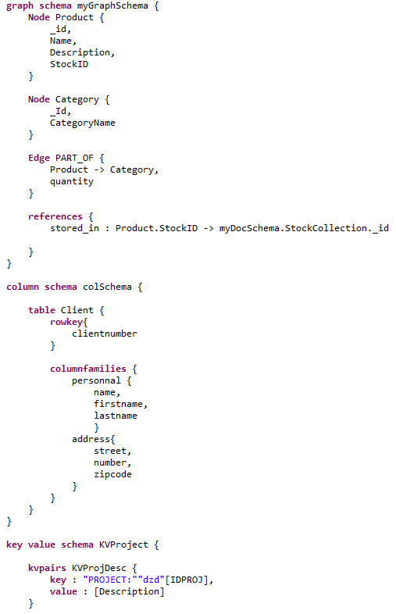
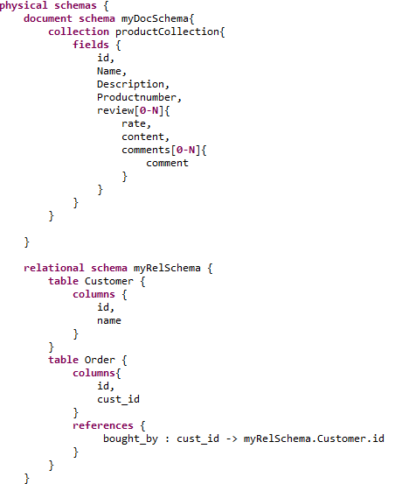
Unified Model

Slide 30
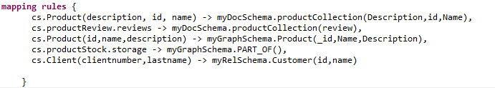
Unified Model
Conceptual
Physical
Mapping

Slide 31
Code generation

Slide 32
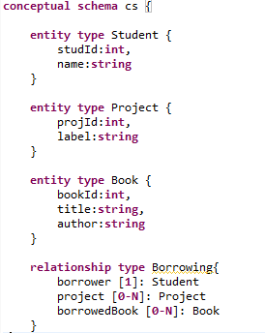
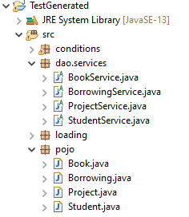
Example
Polystore Model
Acceleo Code Generation
Access Services
Data objects

Slide 33
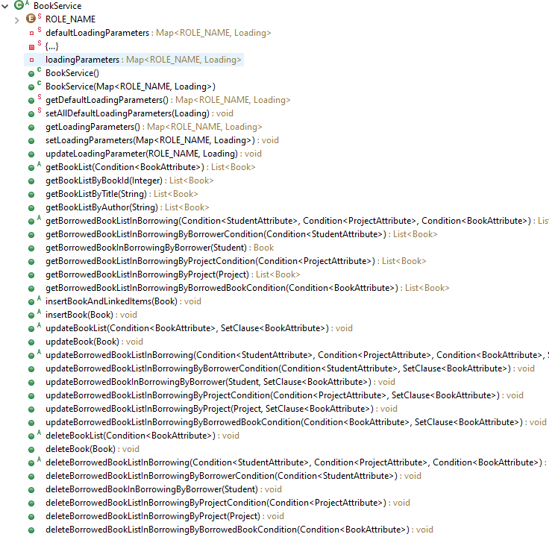
Service

Slide 34
Implementation
Depending on the mapping the implementation of services methods will produce corresponding queries

Slide 35
Implementation
Depending on the mapping the implementation of services methods will produce corresponding queries
DocumentDB dbcollection.find({productName:"SuperCleaner3"})
GraphDB
match (n:Product{productName:“SuperCleaner3"})<--(o:Order)-->(otherProducts:Product) return n,o,otherProducts
Relational DB
Select userid from Orders O JOIN Order_Product OP ON O.Id=OP.OrderId JOIN Product P ON OP.ProductId=P.Id where P.productName=“SuperClean3”

Slide 36
Evolution

Slide 37
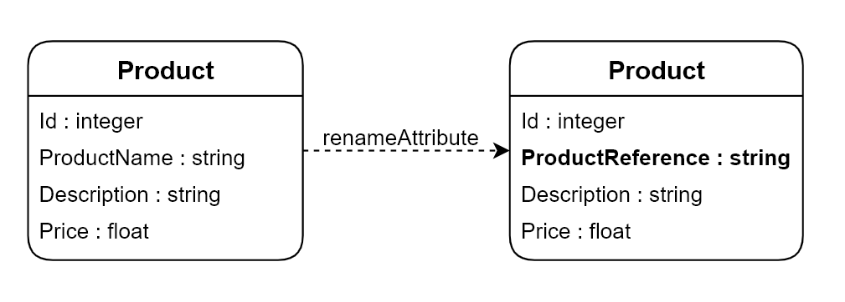

Slide 38
Conceptual Schema Impact
Notes:
Hybrid databases system example
Evolution scenario and artefact to modify

Slide 39
Physical Schema Impact
Notes:
Hybrid databases system example
Evolution scenario and artefact to modify

Slide 40
Physical Schema Impact
Notes:
Hybrid databases system example
Evolution scenario and artefact to modify

Slide 41
Physical Schema Impact
Notes:
Hybrid databases system example
Evolution scenario and artefact to modify

Slide 42
Data and Queries
{
"_id": "5df8b60952264a01b6a8a2fc",
"productId": "product0",
"productName": "SuperCleaner3",
"reviews": [
{
"review_id": "review1",
"user_ref": "user55",
"user_name": "Serena",
"rating": 1,
"title": "Dont buy!!!",
"reviewText": "I dropped it from a 5 stories building and it broke!",
"comments": []
},
...
]
}
}
DocumentDB dbcollection.find({productName:"SuperCleaner3"})
GraphDB
match (n:Product{productName:“SuperCleaner3"})<--(o:Order)-->(otherProducts:Product) return n,o,otherProducts
Relational DB
Select userid from Orders O JOIN Order_Product OP ON O.Id=OP.OrderId JOIN Product P ON OP.ProductId=P.Id where P.productName=“SuperClean3”
Notes:
Hybrid databases system example
Evolution scenario and artefact to modify

Slide 43
Data and Queries
{
"_id": "5df8b60952264a01b6a8a2fc",
"productId": "product0",
"productName": "SuperCleaner3",
"reviews": [
{
"review_id": "review1",
"user_ref": "user55",
"user_name": "Serena",
"rating": 1,
"title": "Dont buy!!!",
"reviewText": "I dropped it from a 5 stories building and it broke!",
"comments": []
},
...
]
}
}
DocumentDB dbcollection.find({productName:"SuperCleaner3"})
GraphDB
match (n:Product{productName:“SuperCleaner3"})<--(o:Order)-->(otherProducts:Product) return n,o,otherProducts
Relational DB
Select userid from Orders O JOIN Order_Product OP ON O.Id=OP.OrderId JOIN Product P ON OP.ProductId=P.Id where P.productName=“SuperClean3”
Notes:
Hybrid databases system example
Evolution scenario and artefact to modify

Slide 44
Data and Queries
{
"_id": "5df8b60952264a01b6a8a2fc",
"productId": "product0",
"productName": "SuperCleaner3",
"reviews": [
{
"review_id": "review1",
"user_ref": "user55",
"user_name": "Serena",
"rating": 1,
"title": "Dont buy!!!",
"reviewText": "I dropped it from a 5 stories building and it broke!",
"comments": []
},
...
]
}
}
DocumentDB dbcollection.find({productName:"SuperCleaner3"})
GraphDB
match (n:Product{productName:“SuperCleaner3"})<--(o:Order)-->(otherProducts:Product) return n,o,otherProducts
Relational DB
Select userid from Orders O JOIN Order_Product OP ON O.Id=OP.OrderId JOIN Product P ON OP.ProductId=P.Id where P.productName=“SuperClean3”
Notes:
Hybrid databases system example
Evolution scenario and artefact to modify

Slide 45
Data and Queries
{
"_id": "5df8b60952264a01b6a8a2fc",
"productId": "product0",
"productName": "SuperCleaner3",
"reviews": [
{
"review_id": "review1",
"user_ref": "user55",
"user_name": "Serena",
"rating": 1,
"title": "Dont buy!!!",
"reviewText": "I dropped it from a 5 stories building and it broke!",
"comments": []
},
...
]
}
}
DocumentDB dbcollection.find({productName:"SuperCleaner3"})
GraphDB
match (n:Product{productName:“SuperCleaner3"})<--(o:Order)-->(otherProducts:Product) return n,o,otherProducts
Relational DB
Select userid from Orders O JOIN Order_Product OP ON O.Id=OP.OrderId JOIN Product P ON OP.ProductId=P.Id where P.productName=“SuperClean3”
Notes:
Hybrid databases system example
Evolution scenario and artefact to modify

Slide 46
Data and Queries
{
"_id": "5df8b60952264a01b6a8a2fc",
"productId": "product0",
"productName": "SuperCleaner3",
"reviews": [
{
"review_id": "review1",
"user_ref": "user55",
"user_name": "Serena",
"rating": 1,
"title": "Dont buy!!!",
"reviewText": "I dropped it from a 5 stories building and it broke!",
"comments": []
},
...
]
}
}
DocumentDB dbcollection.find({productName:"SuperCleaner3"})
GraphDB
match (n:Product{productName:“SuperCleaner3"})<--(o:Order)-->(otherProducts:Product) return n,o,otherProducts
Relational DB
Select userid from Orders O JOIN Order_Product OP ON O.Id=OP.OrderId JOIN Product P ON OP.ProductId=P.Id where P.productName=“SuperClean3”
Notes:
Hybrid databases system example
Evolution scenario and artefact to modify

Slide 47
Evolution Operators
Operations of evolution to perform on conceptual model
Add entity, rename attribute, add relationship, migrate, ...
Notes:
Research questions

Slide 48
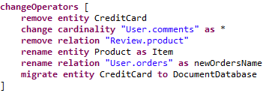
Evolution Operators
Operations of evolution to perform on conceptual model
Add entity, rename attribute, add relationship, migrate, ...
Notes:
Research questions

Slide 49
Evolution Operators
Operations of evolution to perform on conceptual model
Add entity, rename attribute, add relationship, migrate, ...
That specify the manipulations to perform on artefacts :
Conceptual model
Physical structures
The mapping between them
Data
Queries
Notes:
Research questions

Slide 50
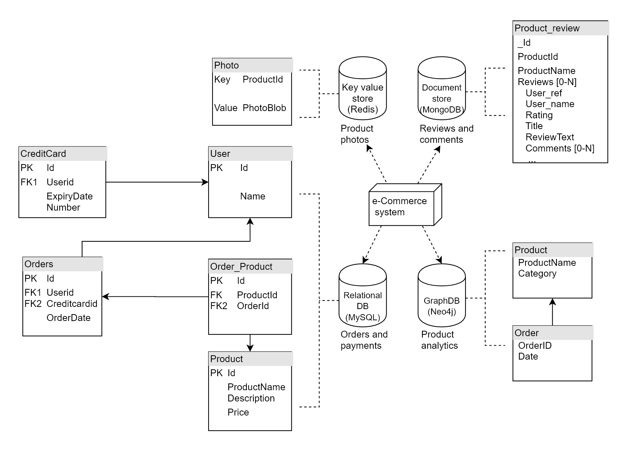
Source Conceptual Schema
Source Physical Schema
Source Data & Queries

Slide 51
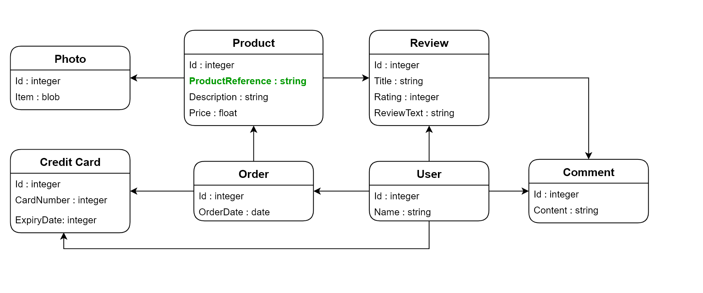
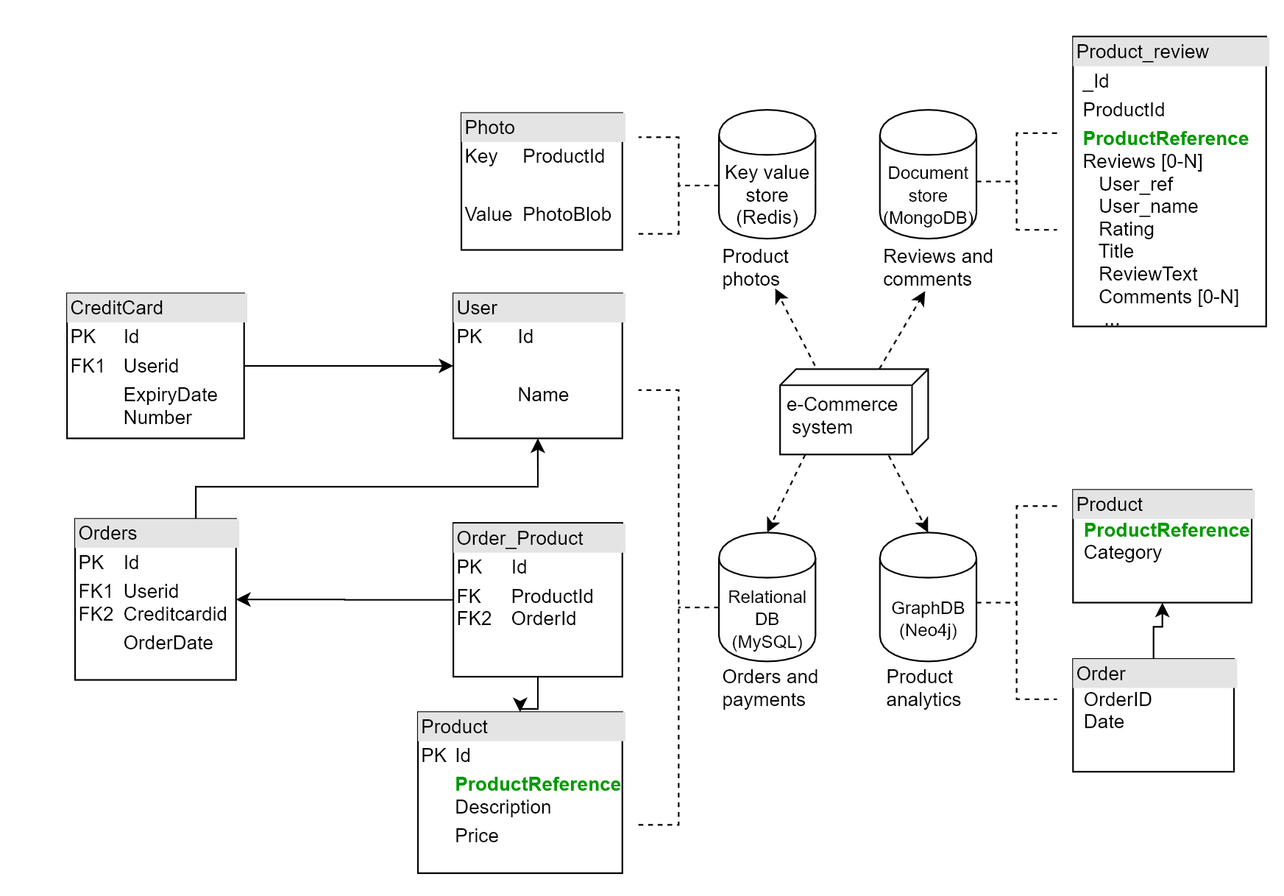
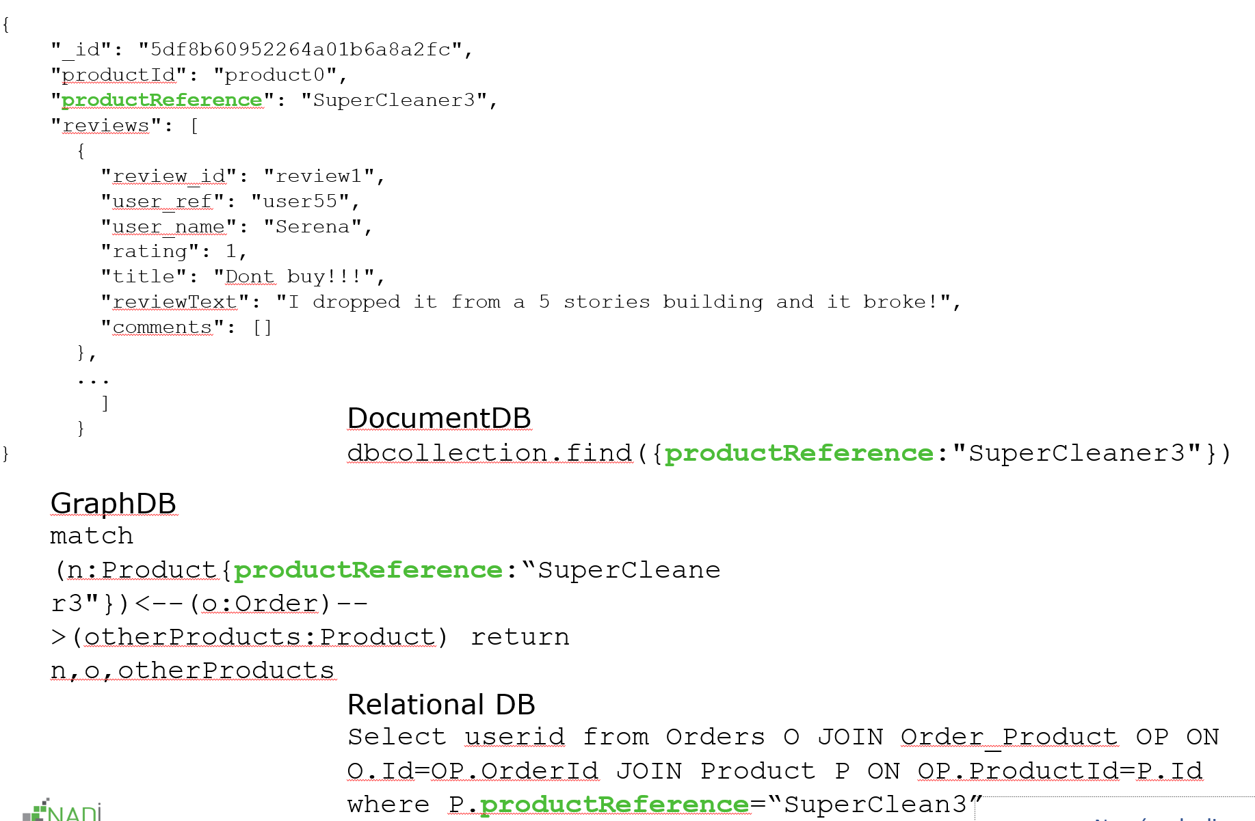
Source Conceptual Schema
Target Conceptual Schema
Source Physical Schema
Target Physical Schema
Source Data & Queries
Target Data & Queries

Slide 52
Source Conceptual Schema
Target Conceptual Schema
Source Physical Schema
Target Physical Schema
Model language for conceptual & physical schema
Source Data & Queries
Target Data & Queries

Slide 53
Source Conceptual Schema
Target Conceptual Schema
Source Physical Schema
Target Physical Schema
Model language for conceptual & physical schema
Mapping rules between them
Source Data & Queries
Target Data & Queries
Notes:
- Mapping rules in order to represent the differnet data modelling strategies.

Slide 54
Source Conceptual Schema
Target Conceptual Schema
Source Physical Schema
Target Physical Schema
Model language for conceptual & physical schema
Mapping rules between them
Evolution Operators
Source Data & Queries
Target Data & Queries

Slide 55
Wrap-up

Slide 56
Current status
Conceptual modeling, physical modeling and mapping rules grammar designed and implemented (Relational, document, column oriented, graph and key value data models)
Code generation of domain model objects and abstract services
Design of evolution operators and impact matrix
Future work
Evaluation of model language
Generation of code implementation
Physical storage information to add in model
Evolution handling implementation
Recommandation of evolution operators to apply
Tests & evaluation!
Notes:
Research questions

Slide 57
Thank you

Slide 58
Challenges
Choice of code generated technology, java code access library or REST API,...?
We will benefit from the numbers of our NoSQL analysis (Pol)
Reconciliation of data on multiple database (identity merging)
Big data aspect and scalability
Integration of the different data migration strategies
...
Notes:
Research questions

Slide 59
Evolution Operators
Model Object | Operator | Conceptual Impact | Physical Schema Impact | Data Impact | Queries Impact
Entity Type | Add | addEntity(...) | A_{rel} A_{doc} | - | -
Attribute | Rename | renameAtt(...) | U_{rel} U_{col} | UD_{doc} UD_{key} UD_{graph} | renameAtt(queries)
...
A_{rel} Execute SQL Create table statement
A_{doc} Execute Create collection statement
U_{rel} Execute SQL alter table statement
U_{col} Execute CQL alter table statement
UD_{doc} Execute rename statement
UD_{key} Delete and add new key value pairs
UD_{graph} Modify nodes
Notes:
Research questions

